Slide 1

Canceled Flights: Can We Predict it

Slide 2
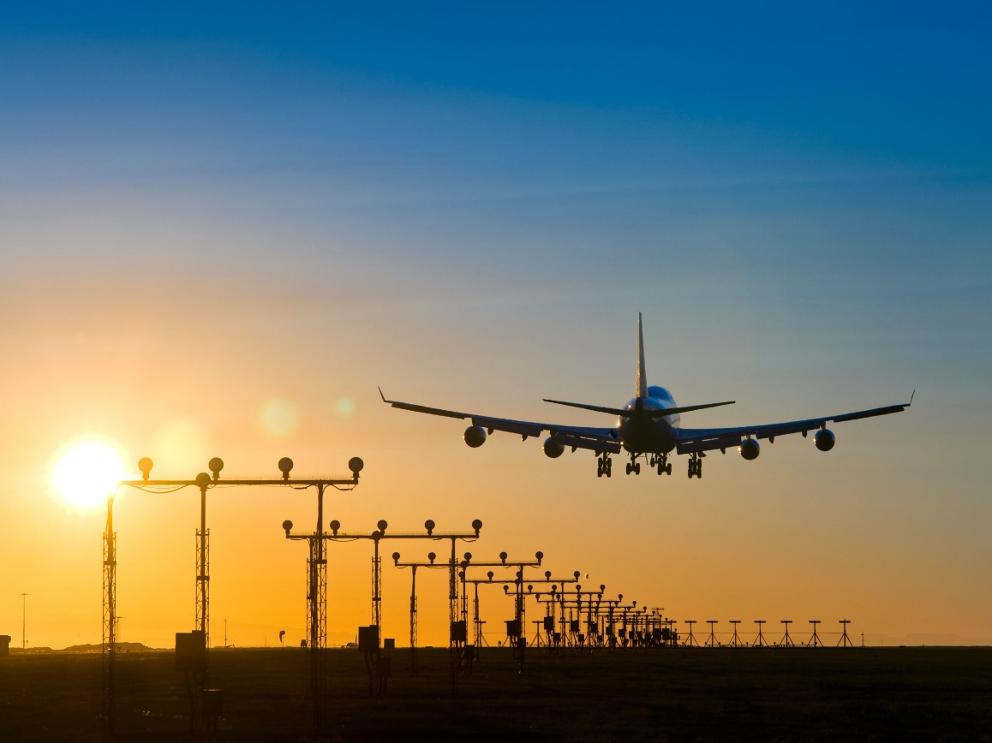
Table of Content
Team Composition
Business Case
Purpose
Data Sources & Cleaning
Data Sets
Predictions
Recommendations
Conclusions & Retrospective
Questions

Slide 3



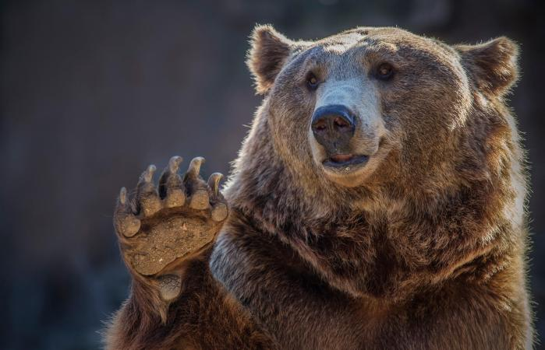
Team Composition (Spirit Animals)
Jeff
David
Graham
Pat

Slide 4
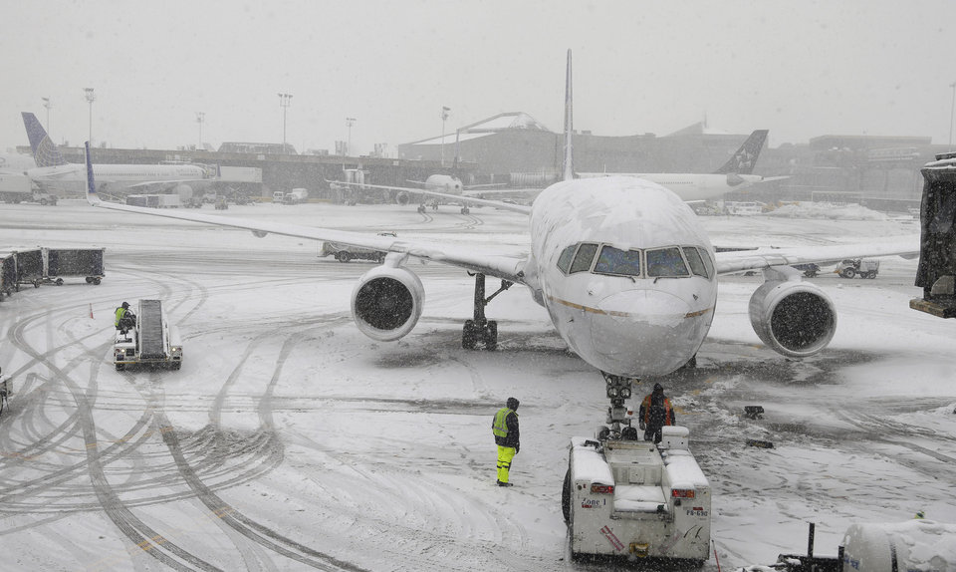
Business Case & Purpose
Approximately $700 billion Industry
$8 billion in Lost Revenue
Cancelations
Delays

Slide 5
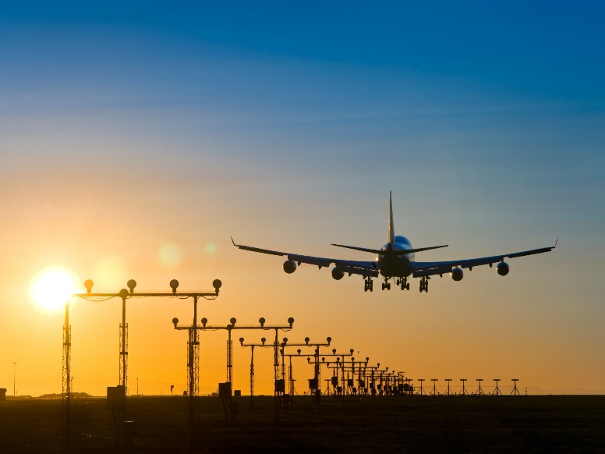
Data Sources & Cleaning
https://www.transtats.bts.gov/Fields.asp
Individual Months Download
Removed Extra Data
https://www.ncdc.noaa.gov/cdo-web/datasets
Individual Reports Generated
Consolidated
OSEMiN

Slide 6
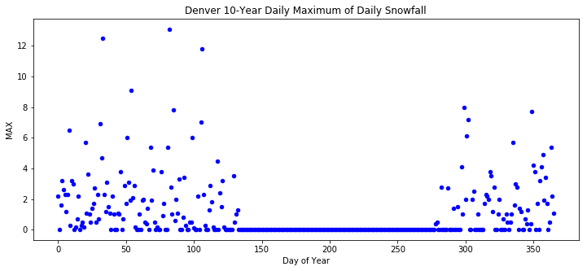
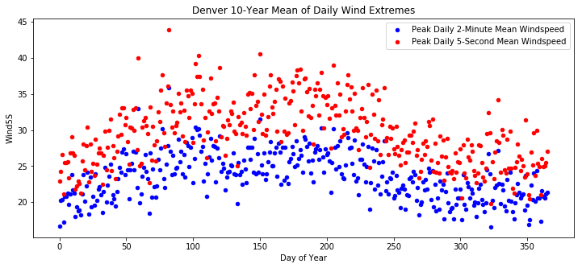

Data Set – NOAA
OSEMiN

Slide 7
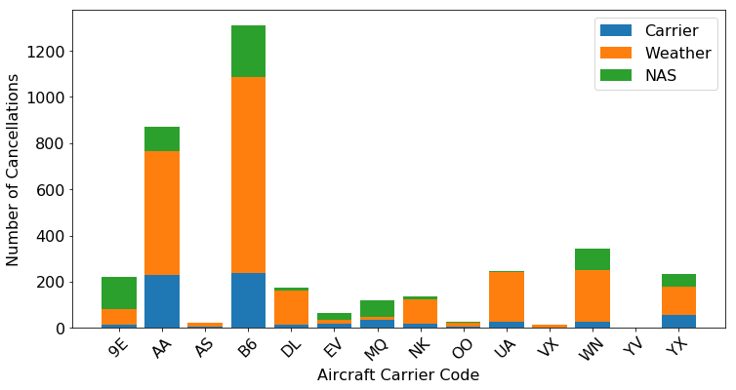
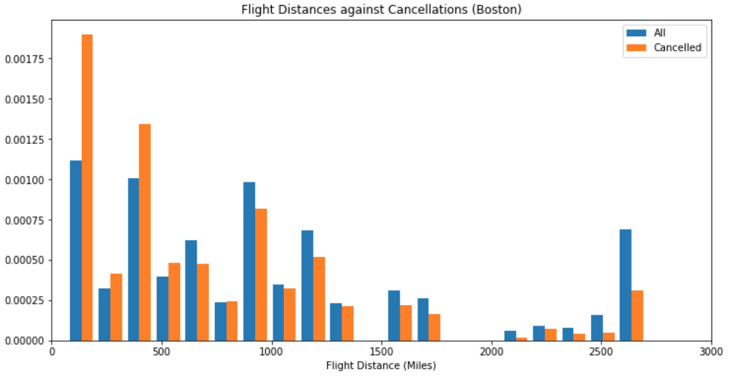

Data Set – BTS
Correlation
Significant variables
Investigation
OSEMiN

Slide 8
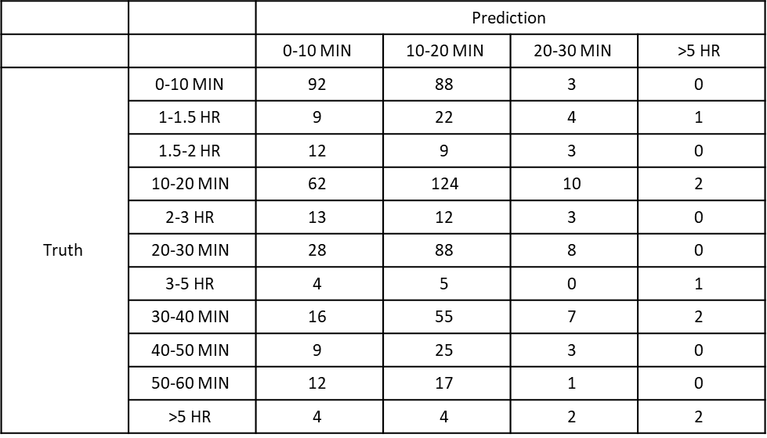
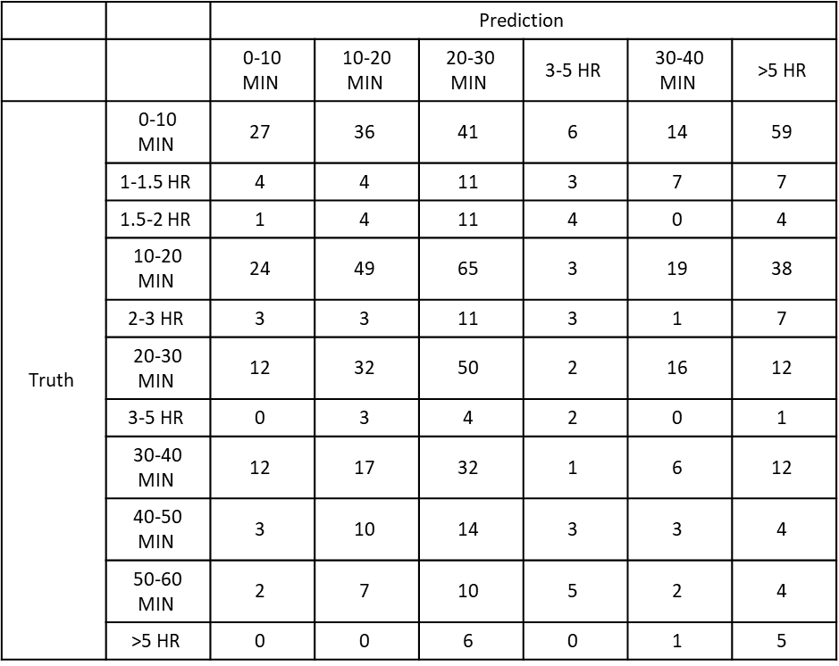
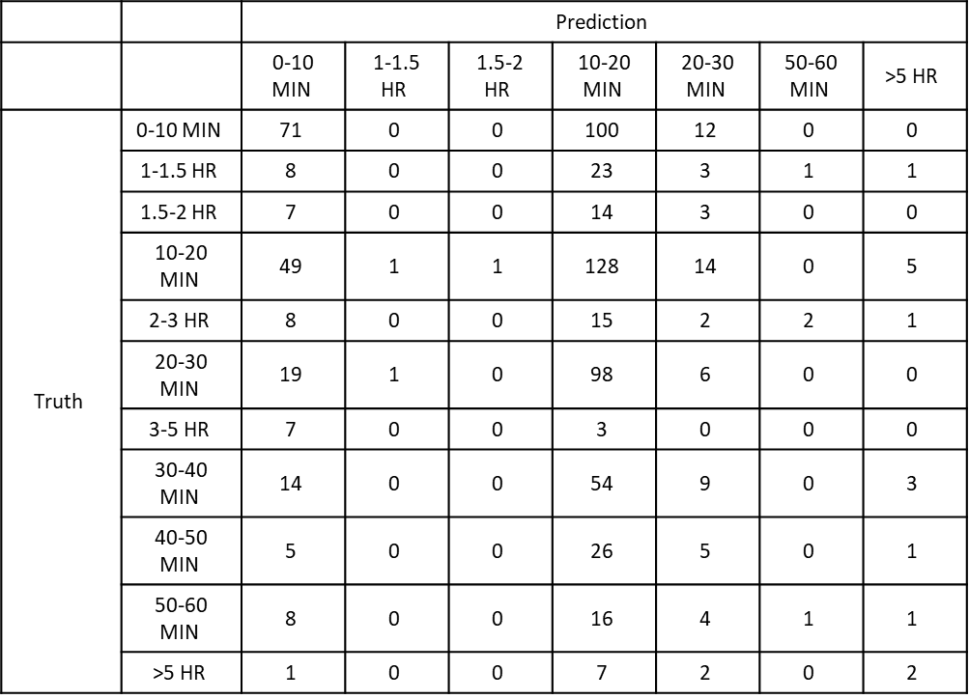
Models/Predictions
Overall Accuracies:
NB – 18%
KNN – 24%
SVM – 30%
Naïve Bayes Model
KNN Clustering Model
SVM Model
Important Factors:
- Snow Drift
- Heavy Fog
- Peak Gust Time
OSEMiN

Slide 9
Recommendations
Work on more rigorously collecting data
Focus on region specific modifications to our models
Create more complex models involving weather between Origin and Destination
Involve characteristics caused by weather
Visibility, average turbulence, runway friction
OSEMiN

Slide 10
Conclusions & Retrospective
Visibility is more important than we thought
Delays not affected by temperatures
Accurate prediction models would need more complex and more reliable weather data

Slide 11

Questions?

